Slide 1
Brainstation Capstone Sprint 1
At-Risk Students - Support for Success
Bobbie Razo 2024.01.13
Notes:
Good Afternoon class, Sriram and Elton. My topic is about: Identifying At-Risk College Students with the hopes to Strengthen them for Success. At-risk students: face a higher likelihood of not completing their degree programs due to various challenges or factors that may hinder their academic success.

Slide 2
Contents
Introduction: Business Problem
Proposed Vision & Impact of Solution
Data
Next Steps
References

Slide 3

Introduction
Student Drop Out Rates in the US
40% of college students dropped out in 2023.
Increasing college dropout rates have negative effects for both individuals and society as a whole.
Notes:
Typically, a college degree is seen as a route to success. But despite this, about 40% of college students drop out every year. This is a jump from previous years and is only expectd to increase year after year.
This can have a widespread impact with not just individual lives but with the full social spectrum including the economy.

Slide 4

Using Data Science To Recognize Clues And Patterns That Precede College Student Dropouts
With historical student data, can student withdrawal actions be predicted by identifying critical indicators?
Early Identification of At-Risk Students
Early Intervention
Resource Implementation: Institution And Government Efforts
Personalized Support Strategies
Student Succeeds
Increased Retention Rates
Notes:
What if we can recognize clues and patterns that precede college student dropouts using data science and machine learning?
With the right information, we can try to leverage predictive analytics to forecast student withdrawal actions.
When we study historical data of both kinds of student populations:
- those that have discontinued their post-secondary education;
- and also, those that have graduated and completed a degree;
we hope to identify related factors and challenges for at-risk students.
Addressing proactively the challenges faced by these students is the key!
Having early identification allows for a timely intervention and implement support strategies so students can overcome academic challenges and succeed in their education journey.
Much of this intervention happens at the Institutional level.
Institutions can apply resources where it's needed most:
These include: remedial programs, academic counseling, peer support, workshops.
It can be tailored in a personalized manner for each individual student.
Much of the schools now already have these programs in place. But it's done in a reactive manner where they are servicing students who are already on the path to be dismissed or dropped out. So, the difference here would be to apply these before students indicate any signs of withdrawing.
Other forms of intervention can also be on the government level: such as financial funding, mental health services, etc.
It can be a collaborative effort between institutions and government to prep more students for success.

Slide 5
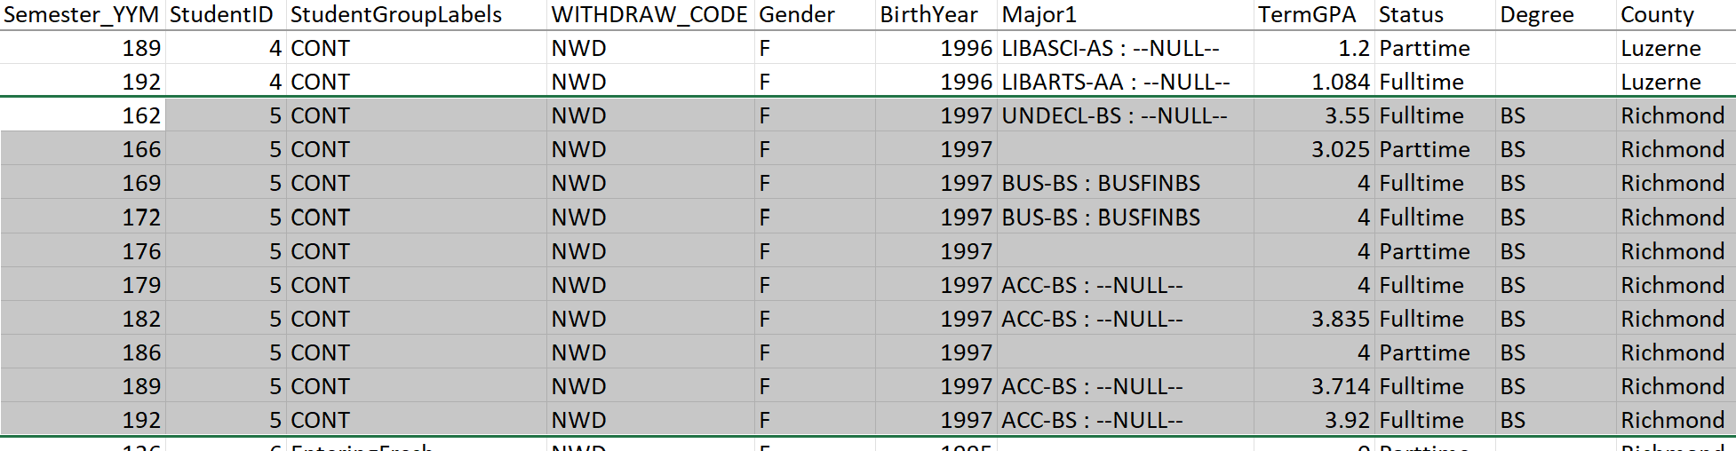
Dataset
10 Years Of Anonymized Student Population Sampling From a Community College
Features: Age | Gender | County | Grade Level | Class Load Schedule | Majors | Minors | GPA | Credit Load | Credit Accumulated | Withdrawn | Degree Acquired | Other Label Info (Honors, Scholarship, Remedial, Campus Resident, Financial Aid, etc.)
Notes:
Now a look into the dataset.
It's an anonymized student population sampling from a community college, spanning 10 years.
It's student records per semester. As you can see here in the chart: a student will appear multiple times for each semester present.
The extracted data features include:
Age
Gender
County
Academic level (Freshman, Sophomore, etc)
Class load schedule: Full-time or Part-time
Majors/Minors
GPA
Credit data
Degree Completed
Withdrawn Flag
Other Info Labels (other supporting info. like Honors, Scholarship, Remedial, Dorm resident, Financial Aid, etc)
This last column of other info label indicates the different kinds of groups a student has: whether they are in Honors, have scholarships, receive financial aid, dorm on campus, and such. Anything that can paint a picture of the student's life as much as possible.

Slide 6
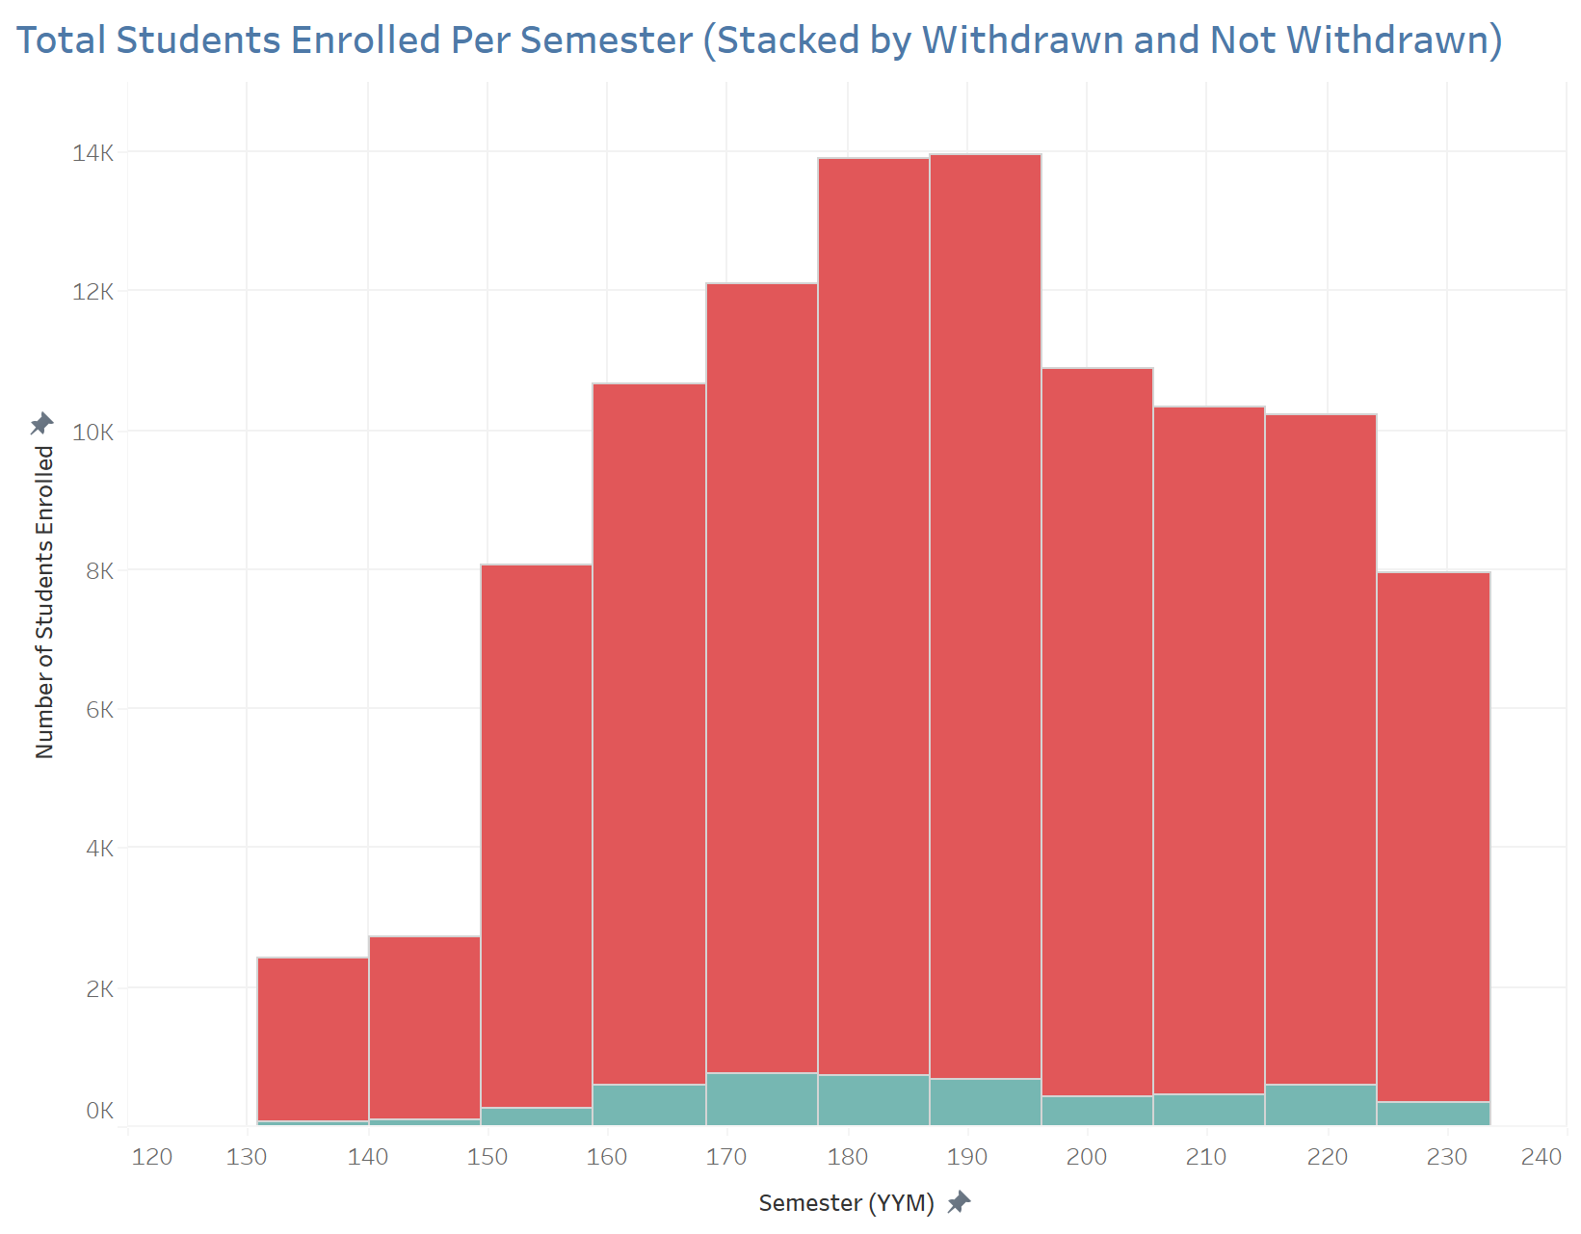
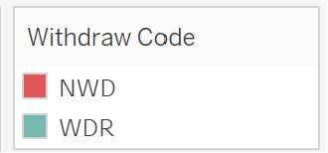
Dataset: Preliminary EDA
Unbalanced distribution for Withdrawn vs. Not Withdrawn Students
Per Semester data, creates duplicate students, requires processing
Notes:
Initials observations
A couple of concerns that's been identified so far are:
1. Skewed Data: with regards to the number of records identified as withdrawn ( very few ) versus not withdrawn.
2. Because the data is per semester, you have duplicate rows per student, which needs to be considered to see how a student is progressing with each semester they are in attendance.
These should be addressed for the project's next steps.

Slide 7
Next Steps
More Processing Is Required
More features can be extracted through data transposition: age at start of college, tenure, AVG GPA, Dummy Variables for Student Groups
Determine more Withdrawn students occurring between semesters.
Use of Up/Down Sampling for the unbalanced Withdrawn and Not Withdrawn Distribution
Assess using the SWOT Analysis (Strength, Weakness, Opportunities and Threats)
Strategize & Implement Modeling
Notes:
Next steps
- This definitely calls for more EDA and processing.
- More features can be extracted through data transposition:
1. age when a student first start or end their program
2. such as how long a student is in a program
3. average gpa
* Another important revelation is the occurrence of withdrawals in between semesters which is not recorded here. A student can complete a semester but simply never return and enroll the following semester. Should these students be considered dropped out? This can be determined with processing.
Sriram have given us the lesson earlier today and also this was suggested by our TA. The use of Up/Down sampling for the unbalanced withdrawn and not withdrawn distribution: processes of changing the resolution or frequency of a dataset to hopefully balance it out more.
- Assess using the SWOT Analysis (Strength, Weakness, Opportunities and Threats) which is a framework for looking at internal and external factors that can impact the success or failure of this project.

Slide 8
Thank you
References:
Learnopoly College Dropout Rate Statistics
Educationdata.org College Dropout Rates

